Slide 1
Understanding advertising
Task A: Comparing promotions
1) Use two different methods to show that packs of 6 rolls are better value for money than packs of 4 rolls.
4 pack of soft rolls
90 p
6 pack of soft rolls
£1.20
E.g. Finding the price of 12
Finding the unit price
0.9 × 3 = 2.7
0.9 ÷ 4 = 0.225
(22.5 p per roll)
1.2 × 2 = 2.4
1.2 ÷ 6 = 0.2
(20 p per roll)
Packs of 6 are better value for money. 12 would cost £2.40 which is cheaper than buying in packs of 4 (£2.70)
The pack of 6 has a cheaper price per roll so is better value for money.
(There are other valid methods.)
2) Aisha needs 500 g of mushrooms for a recipe which feeds 2 people.
Mushrooms 150 g
80 p
Mushrooms 400 g
£1.10
Mushrooms 600 g
£1.80
a) For each pack, what is the price per 100 grams?
0.8 ÷ 1.5 = 0.533…
1.1 ÷ 4 = 0.275
1.8 ÷ 6 = 0.3
Approximately 53.3 p per 100 g
27.5 p per 100 g
30 p per 100 g
b) What would be the cheapest way to buy enough mushrooms to feed 2 people?
Even though the 400 g is better value for money, the cheapest way to get 500 g is buying one pack of 600 g at £1.80
c) What would be the cheapest way to buy enough mushrooms to feed 4 people?
Aisha would need 1000 grams.
Buying one pack of 600 g and one pack of 400 g would be cheapest.
1.1 × 3 = 3.3
1.1 + 1.8 = 2.9
1200 g for £3.30
1000 g for £2.90
d) What would be the cheapest way to buy enough mushrooms to feed 8 people?
Aisha would need 2000 grams.
The 400 g pack is the best value for money and buying 5 would be exactly 2000 g so no wastage.
1.1 × 5 = 5.5
5 packs of 400 g for £5.50

Slide 2
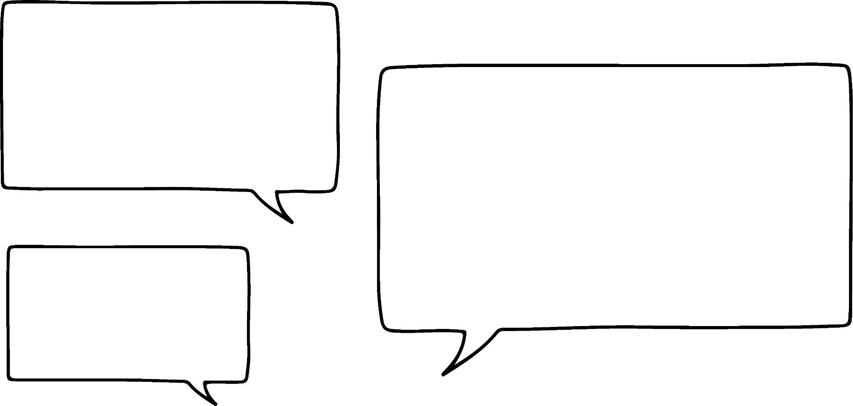

Understanding advertising
3) Which of these promotions are good value for money? Explain your answer.
Pears
39 p each
3 for £1
0.39 × 3 = 1.17
Save 17 p when buying 3
This seems like a reasonable saving if you will eat 3 pears before they go off.
Ice cream tubs
£5.30 each
Any 4 for £21
5.30 × 4 = 21.2
Save 20 p when buying 4
Even though this is a higher saving than the pears it is on a much higher cost so as a percentage saving is less. You would also need to find space and a use for 4 tubs of ice cream.
This does offer slightly better value for money but not necessarily a good promotion.
Veggie sausages
£2.30 each
Any 3 for £7
2.30 × 3 = 6.90
The promotion is more expensive than the original price.
This is definitely not good value for money.
4) Lucas sees this promotion in a supermarket.
Fizzy orange
£1.80 each
Buy 1 get 1 half price
When I was in here last week they cost £1.30 each but there was no promotion.
Does this promotion offer a better deal than the price Lucas saw last week?
1.30 × 2 = 2.6
At last week’s price 2 bottles would cost £2.60
1.80 + 0.9 = 2.7
Buying one at full price and one at half price this week means 2 bottles cost £2.70
This promotion does not offer a saving compared to last week’s prices.
‹#›

Slide 3
Understanding advertising
Task B: Unit pricing
1) Which of these unit pricings are correct?
a)
Strawberries (400 g)
£1.89
£4.73 per kg
c)
Silverskin onions (440 g)
79 p
31 p per 100 g
1.89 ÷ 4 = 0.4725
Correct to 2 d.p.
79 ÷ 4.4 = 17.95
This is possibly a case where one is a mass when drained.
0.4725 × 10 = 4.725
Incorrect
b)
Twin pack Mango
£1.79
89 p each
d)
Wrapping foil (20 m)
99 p
4 p per metre
1.79 ÷ 2 = 0.895
Rounding conventions mean this should be 90 p
This is much closer to 5 p than 4 p so incorrect.
89.5 p
99 ÷ 20 = 4.95
2) Which of these is the best value for money?
Crisps 6 pk × 25 g
£1.25
0.83 p per gram
Crisps 4 pk × 30 g
£1
25 p each
Crisps 15 pk × 30 g
£3.80
£0.84 per 100 g
83.33… p per 100 g
25 p for 30 g
84.44… p for 100 g
8.333… p for 10 g
83.33… p for 100 g
Both the 6 pk of crisps and the 4 pk of crisps are the best value for money.
‹#›

Slide 4

Understanding advertising
Task C: Analysing adverts
1) A ‘low sugar’ box of muesli advertises 20% less sugar.
Low sugar
a) How much sugar would be in 100 g of low sugar muesli?
Normal muesli
16 grams
muesli
b) If a teaspoon is 4.2 grams how many teaspoons of sugar are in a 30 gram serving of low sugar muesli?
Energy
Fat
Saturates
30 gram serving has 4.8 g of sugar
375 Kcal
6.2 g
0.9 g
Sugars
That is just over 1 teaspoon of sugar (1.14…)
20 g
Amounts Per 100 g
of a teaspoon.
c) A different brand of muesli advertises 5.5 g of sugar per 40 gram serving. Which muesli has the least sugar?
5.5 g of sugar per 40 g is 13.75 g of sugar per 100 g.
This is a lower sugar content than the ‘low sugar’ version of the original muesli.
2) Roy’s rides makes and sells motorbikes. Their advert claims:
Our motorbikes hold their value much better than our competitors.
a) The average depreciation of the value of a motorbike in its first year is 20%. What would a motorbike worth £2500 new be worth after one year?
2500 × 0.8 = 2000
After 1 year the value would be £2000
Here are the figures for the value of a motorbike from Roy’s rides and a motorbike from their nearest competitor.
 | Roy’s rides
New | £1800
1 yr old | £1350
 | Competitor
New | £5200
1 yr old | £4420
b) Give a statistic to support the claim made by Roy’s rides
1800 − 1350 = 450
5200 − 4420 = 780
There is a smaller decrease in value for the motorbike at Roy’s rides than their competitor.
c) Give a statistic which does not support the claim.
1350 ÷ 1800 = 0.75 (25% decrease)
The motorbike at Roy’s rides was cheaper initially. It depreciates by 25% whereas the competitor’s depreciates by 15%.
Mathematics in Education and Industry
v2.4

